Slide 1
Penetration Report
PRESENTATION

Slide 2
Agenda
Introduction
Victim 1 Pentest
Victim 2 Pentest
Victim 3 Pentest
Victim 4 Pentest

Slide 3
All the Victim machines were discovered using nmap scan over the local network nmap 192.168.17.0/24
Discovery

Slide 4
Victim 1 pentest
Too easy!

Slide 5
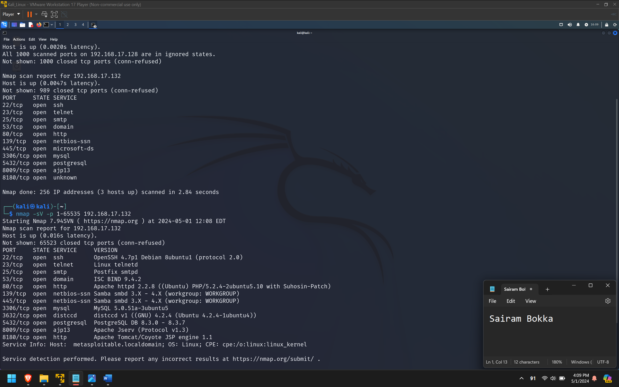
Information gathering
We gather more information about the machine using a detailed nmap scan over all the ports with version detection enabled.
Nmap –sV –p 1-65535 192.168.17.132
We immediately see a lot of outdated services running on different ports.

Slide 6
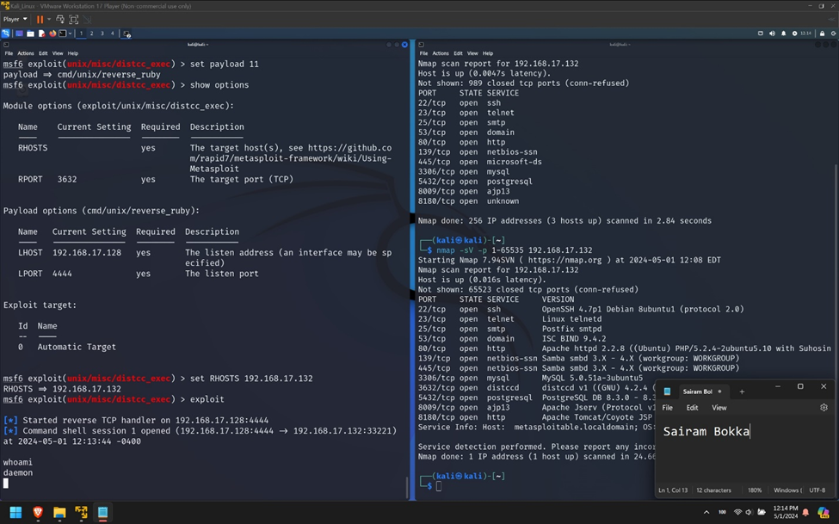
Exploitation
Distccd exploitation: The distcc program has a daemon running as a network service which is vulnerable to DistCC Daemon Command Execution and can be exploited using the Metasploit module.
We use the distcc_exec module available in metasploitable console and set the RHOST to the IP address of the victim and exploit. We get a remote shell with user daemon.

Slide 7
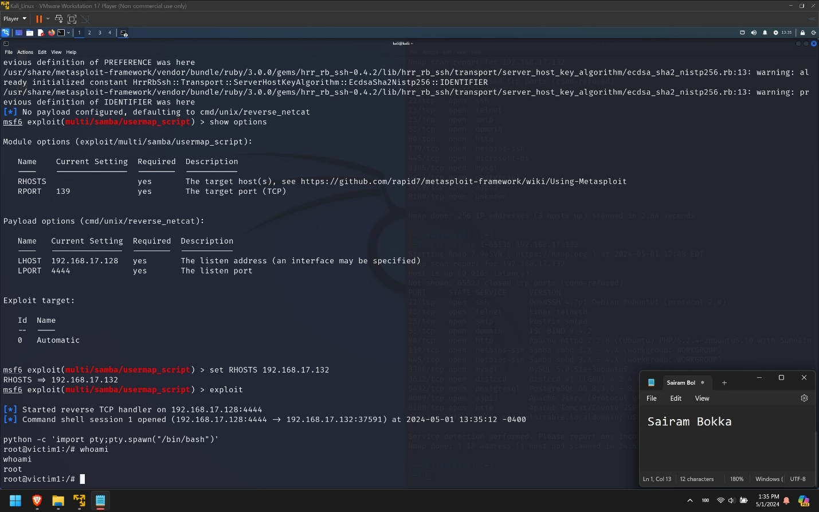
Privilege escalation
Samba Exploitation: This version of Samba smbd 3.x – 4.x is vulnerable to one of the exploit modules in Metasploit called samba usermap_script.
We set the RHOST as our victim PC IP address and run the exploit. We get a remote shell access on the victim PC. Now using python, we spawn an interactive shell, which by default for samba, runs with root privileges.

Slide 8
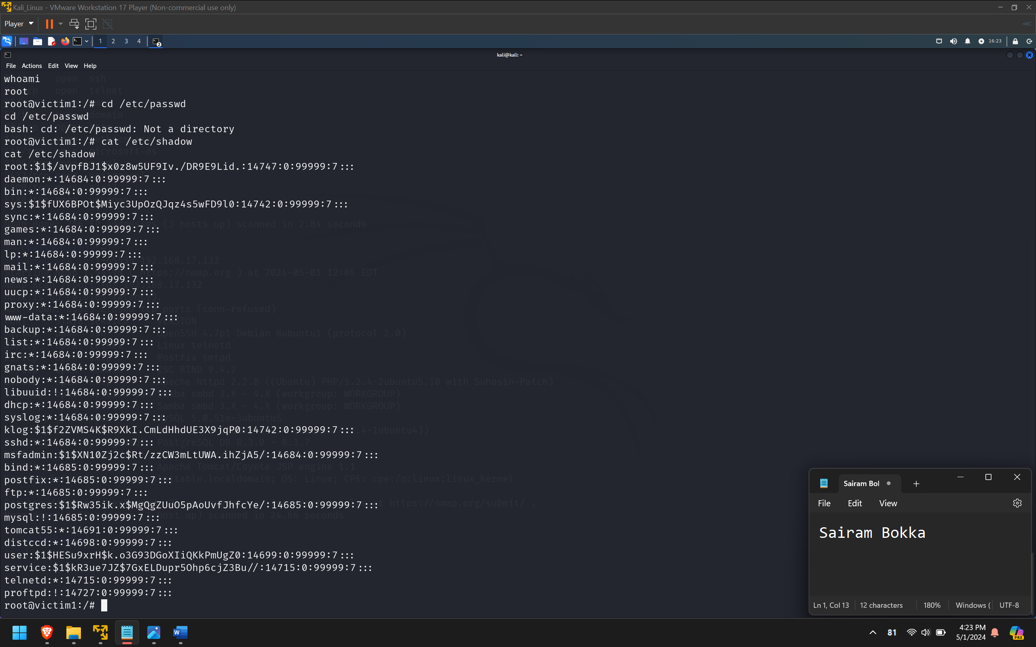
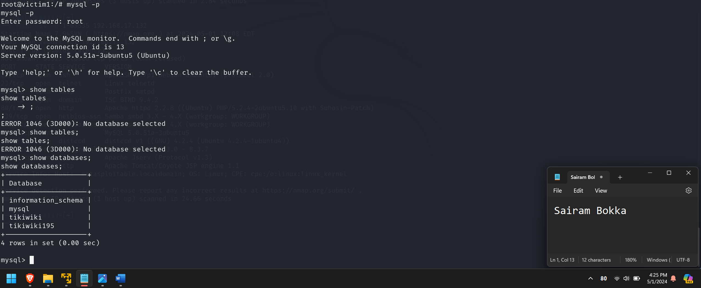
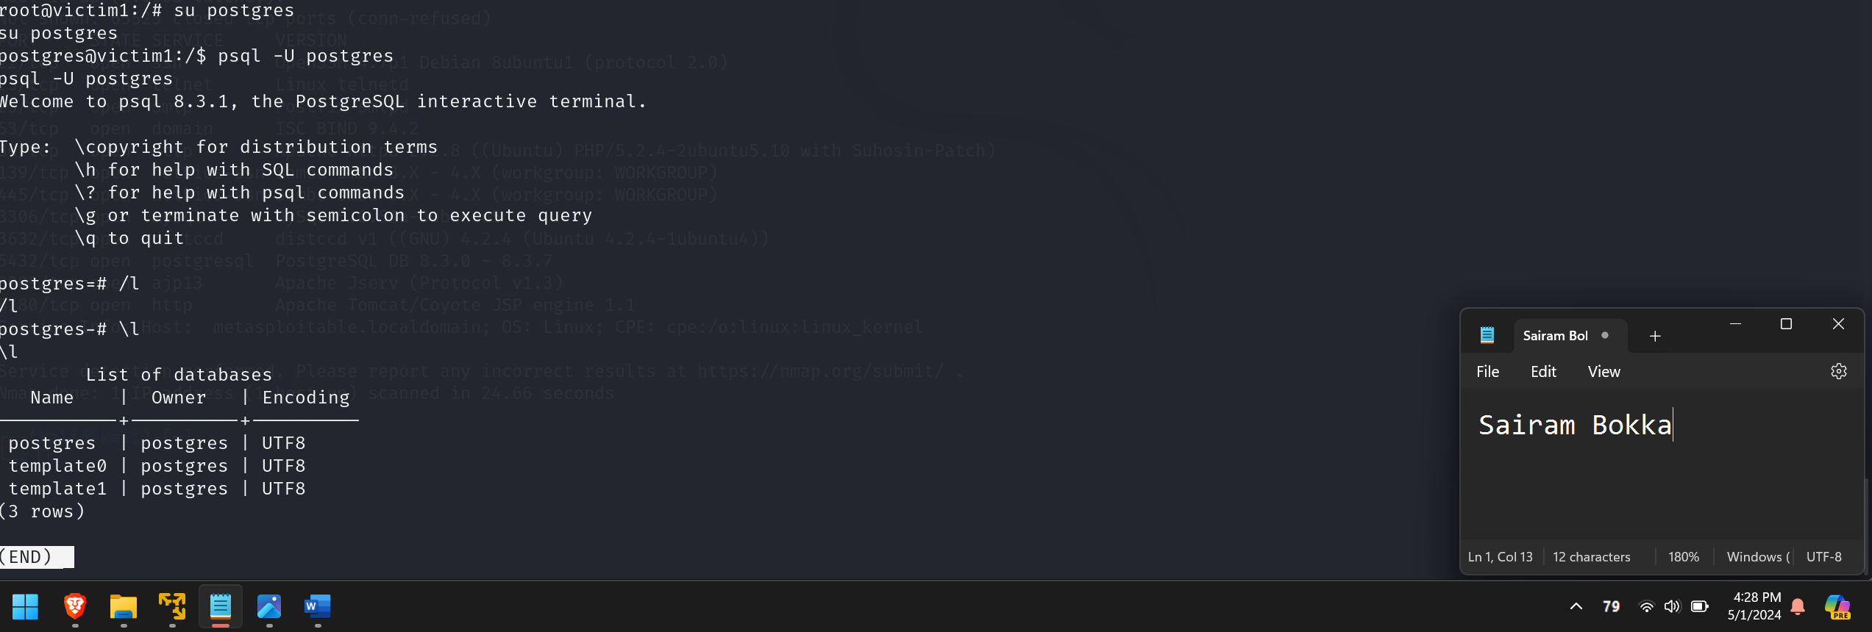
Post exploitation
8

Slide 9
Victim 2 pentest
Made for Exploitation?

Slide 10
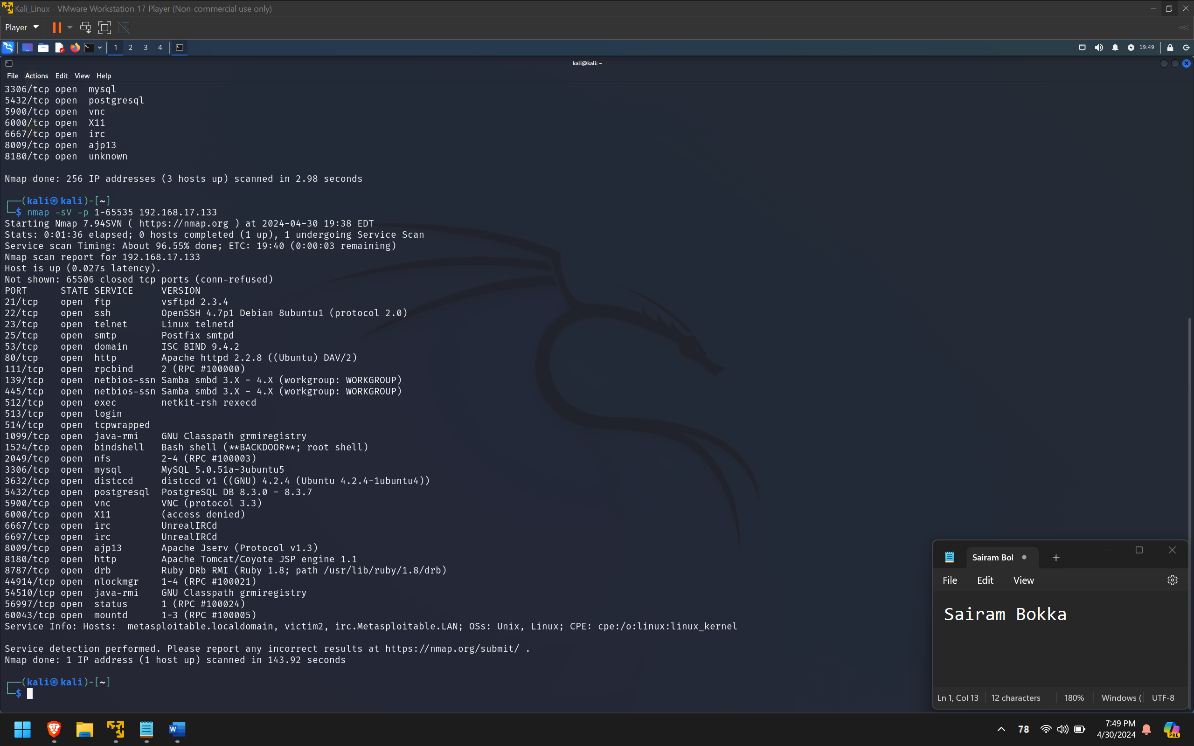
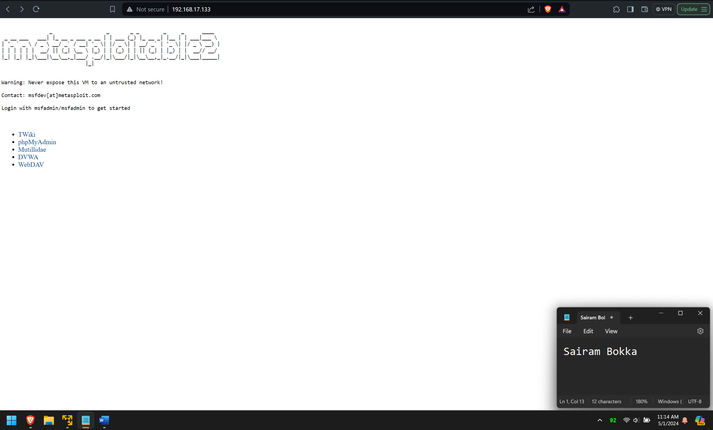
Information gathering
We gather more information about the machine using a detailed nmap scan over all the ports with version detection enabled.
Nmap –sV –p 1-65535 192.168.17.133
There are multiple vulnerable web applications hosted on this machine. Some of them are multidae, DVWA, and WebDAV. We can exploit almost all these applications and gain remote access to the victim machine.

Slide 11
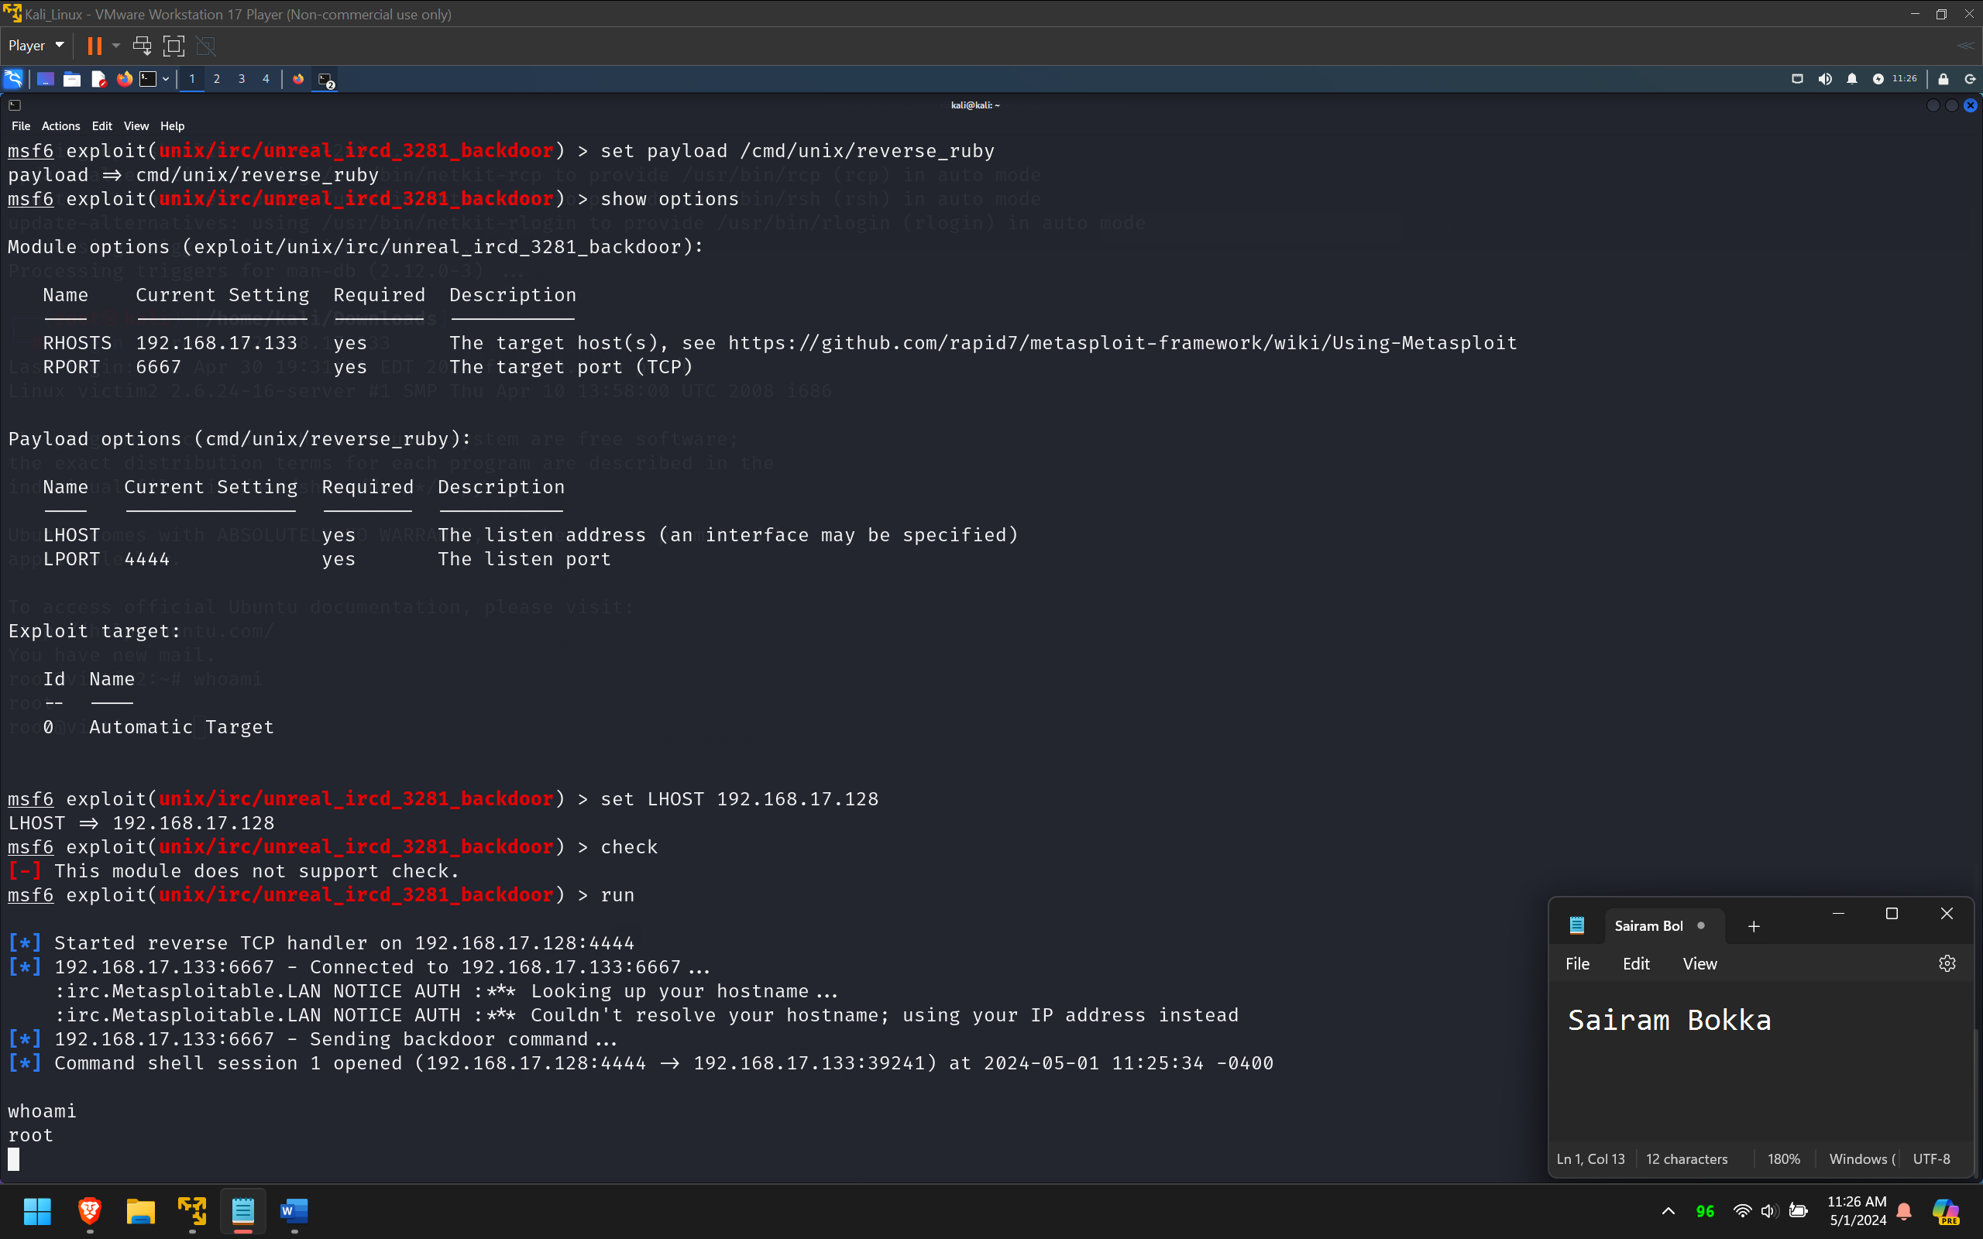
Exploitation
Gaining Access: the username and password to access the machine are displayed on the home page of the webapp. They are msfadmin:msfadmin. We can use these credentials to login into the victim machine.
Unreal IRCD backdoor: On port 6667, Victim machine runs the UnreaIRCD IRC daemon. This version contains a backdoor that went unnoticed for months - triggered by sending the letters "AB" following by a system command to the server on any listening port. Metasploit has a module to exploit this to gain an interactive shell

Slide 12
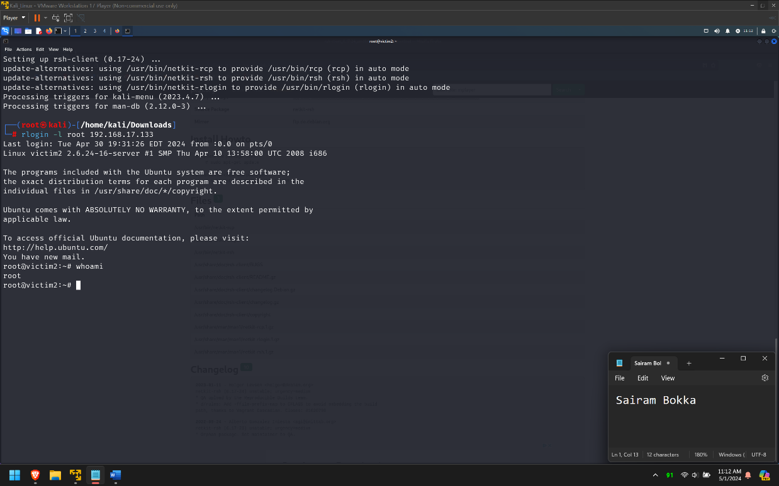
Lazy Exploitation
rlogin vulnerability: TCP ports 512, 513, and 514 are known as "r" services, and have been misconfigured to allow remote access from any host. We can just run rlogin as root user from any linux machine to gain access to the victim machine as root user.

Slide 13
Victim 3 pentest
We are getting there!

Slide 14
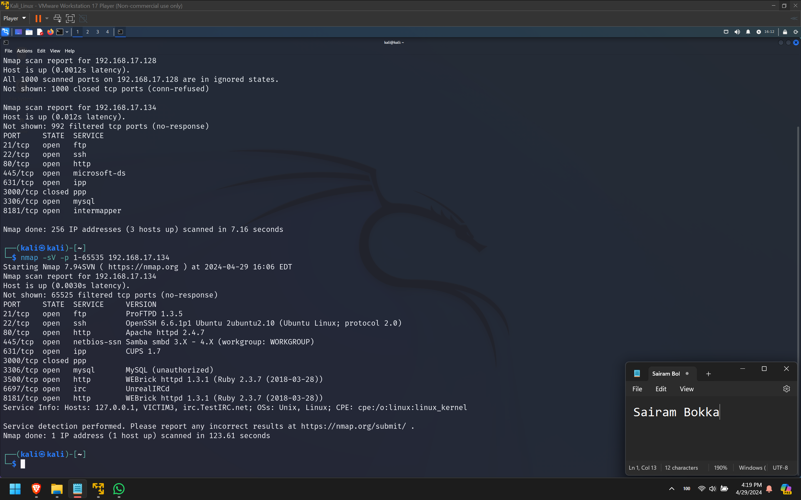
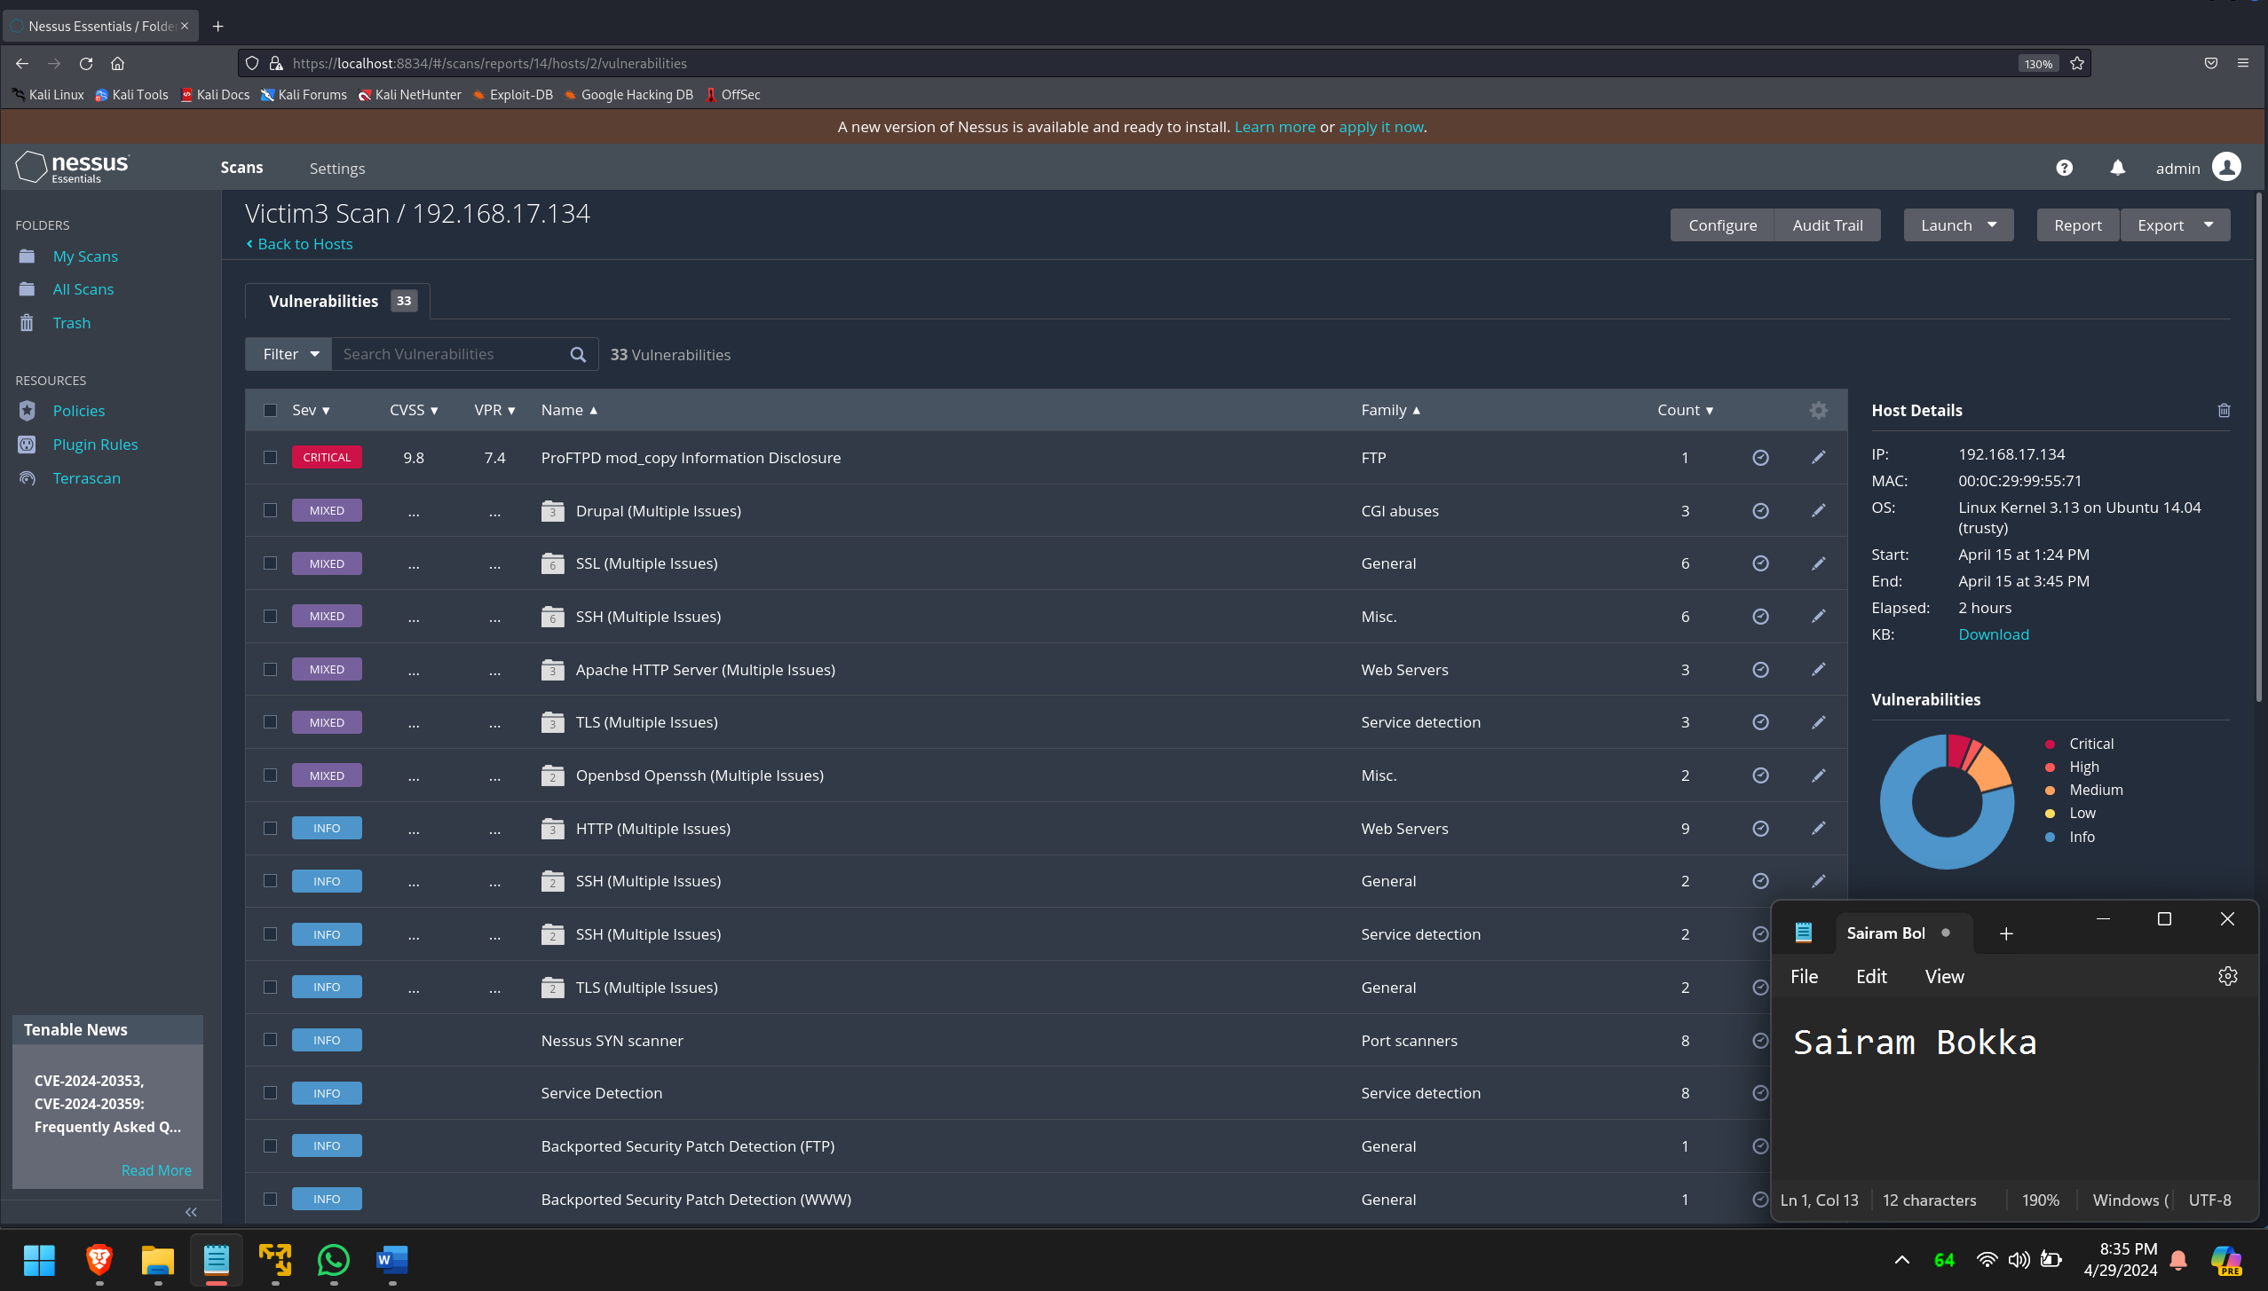
Information gathering
We gather more information about the machine using a detailed nmap scan over all the ports with version detection enabled.
Nmap –sV –p 1-65535 192.168.17.134
After doing a basic network scan using nessus, we find out a lot of high-critical vulnerabilities in the machine. We will check every port and service for vulnerabilities and try to exploit them.

Slide 15
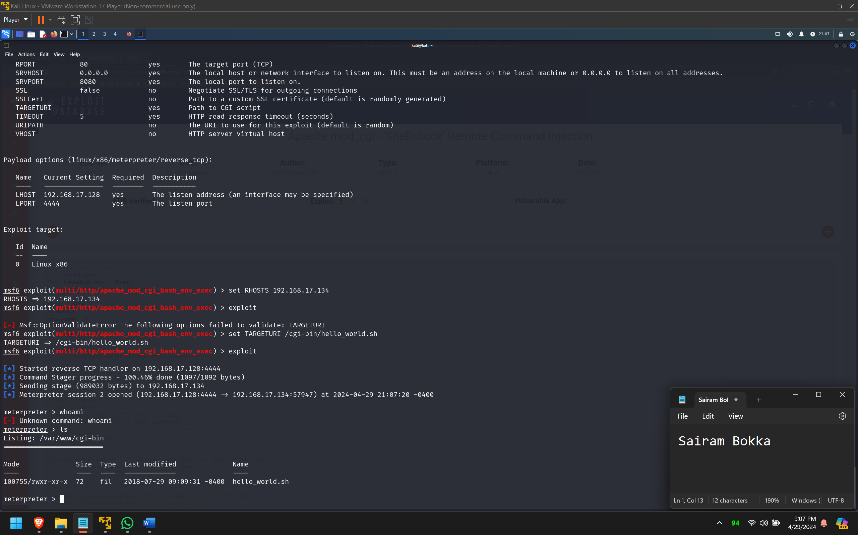
Exploitation
We open metasploitable and search for any available exploits for ProFTPD, because according to nessus, it is a critical vulnerability that could allow for remote code execution.
We use exploit -> unix/ftp/proftpd_modcopy_exec and set payload -> cmd/unix/reverse_perl
After setting the RHOSTS and LHOST, we run the payload, which creates a remote shell to the victim machine.

Slide 16
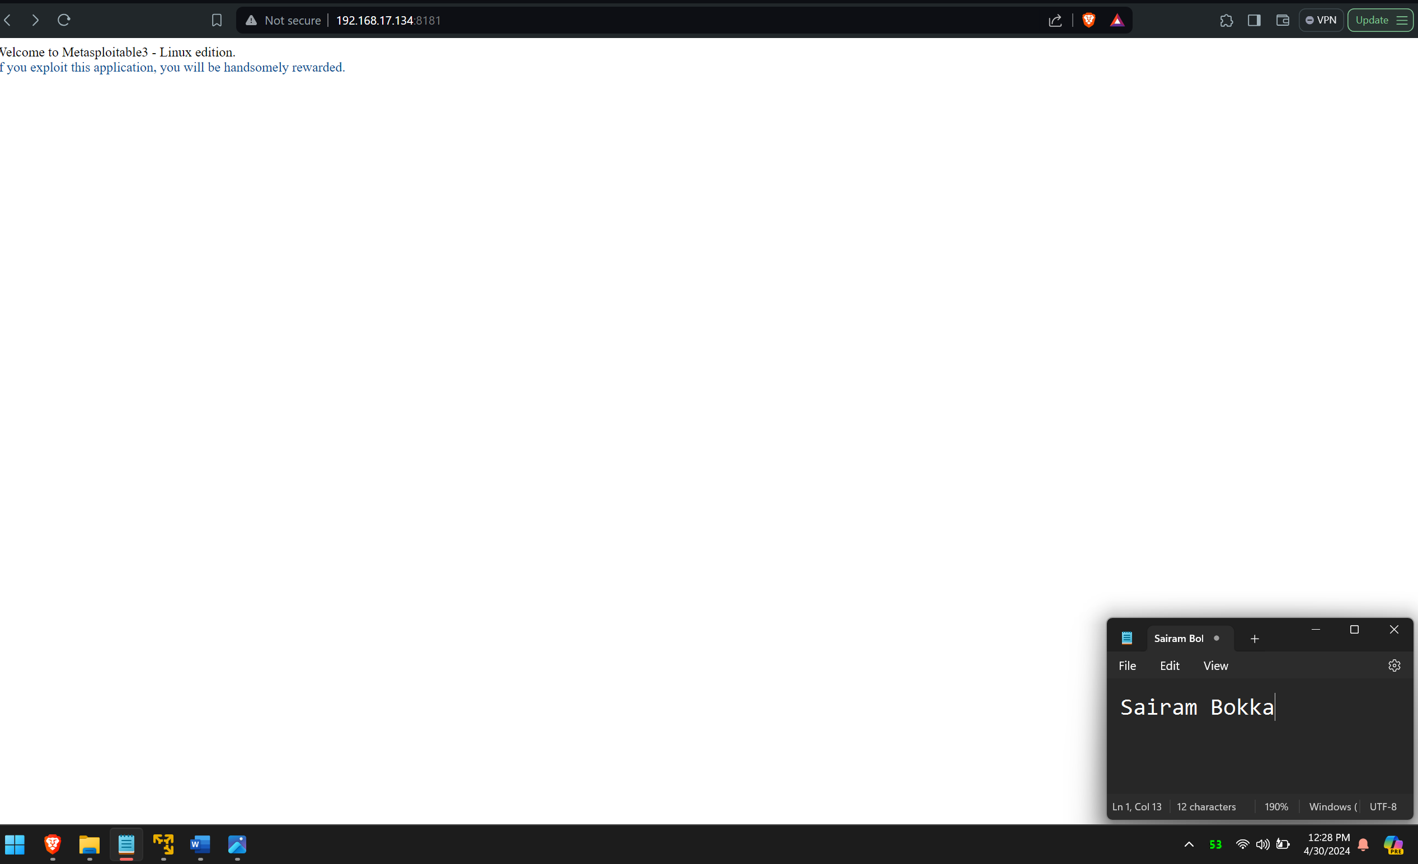
Privilege escalation : Ruby on rails application exploit

Slide 17
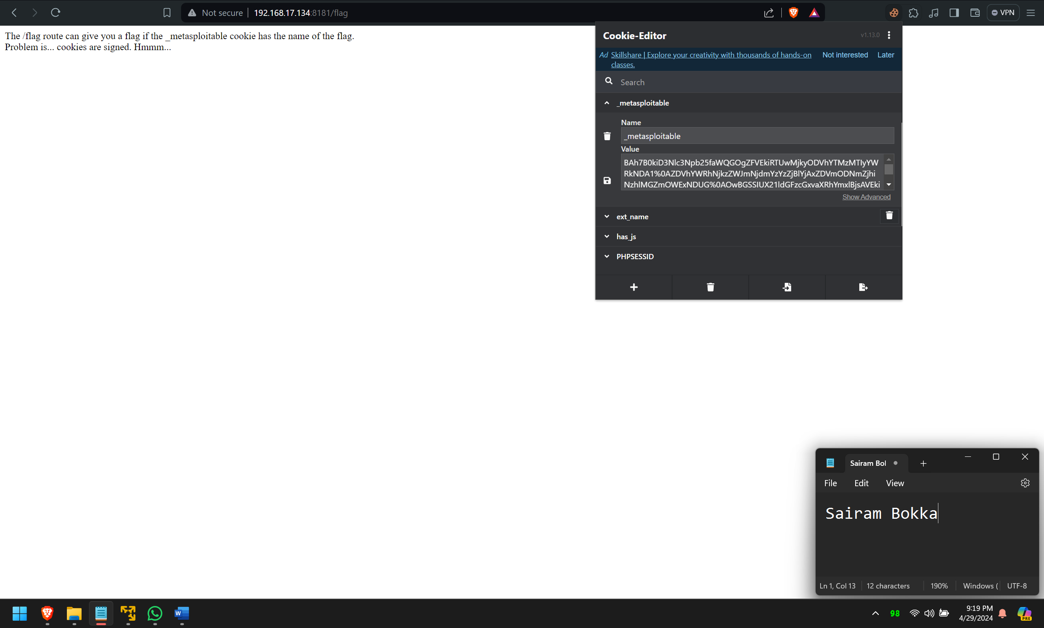

Slide 18
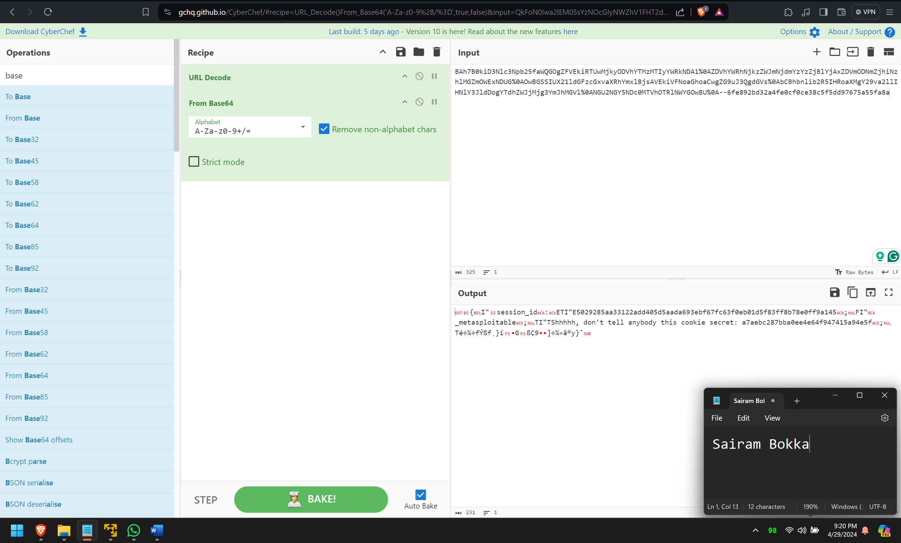

Slide 19
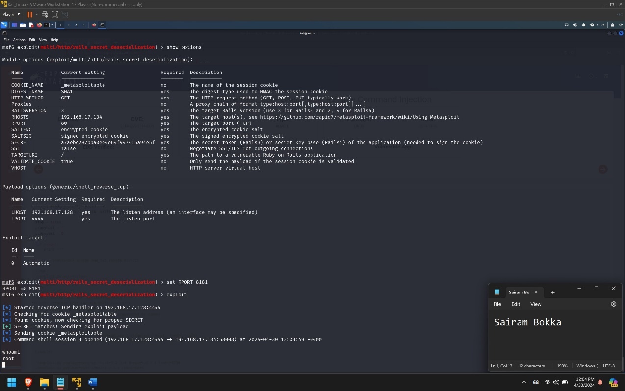
Privilege escalation
We use this value to break into the application using one of the exploits in metasploitable called rails secret deserialization which can use this cookie value to get a remote session.
Now we get shell access as root.

Slide 20
Recommendations
Update and patch systems
Review and harden the web server configuration
Implement strict input validation and sanitization mechanisms
Implement strong authentication mechanisms
Use strong encryption algorithms and properly configure SSL/TLS certificates
Implement proper error handling mechanisms
Ensure that the web application runs with the least privileges necessary to perform its functions
Conduct regular penetration testing and vulnerability assessments to identify and address any new security issues

Slide 21
Victim 4 pentest
Finally, a challenge!

Slide 22
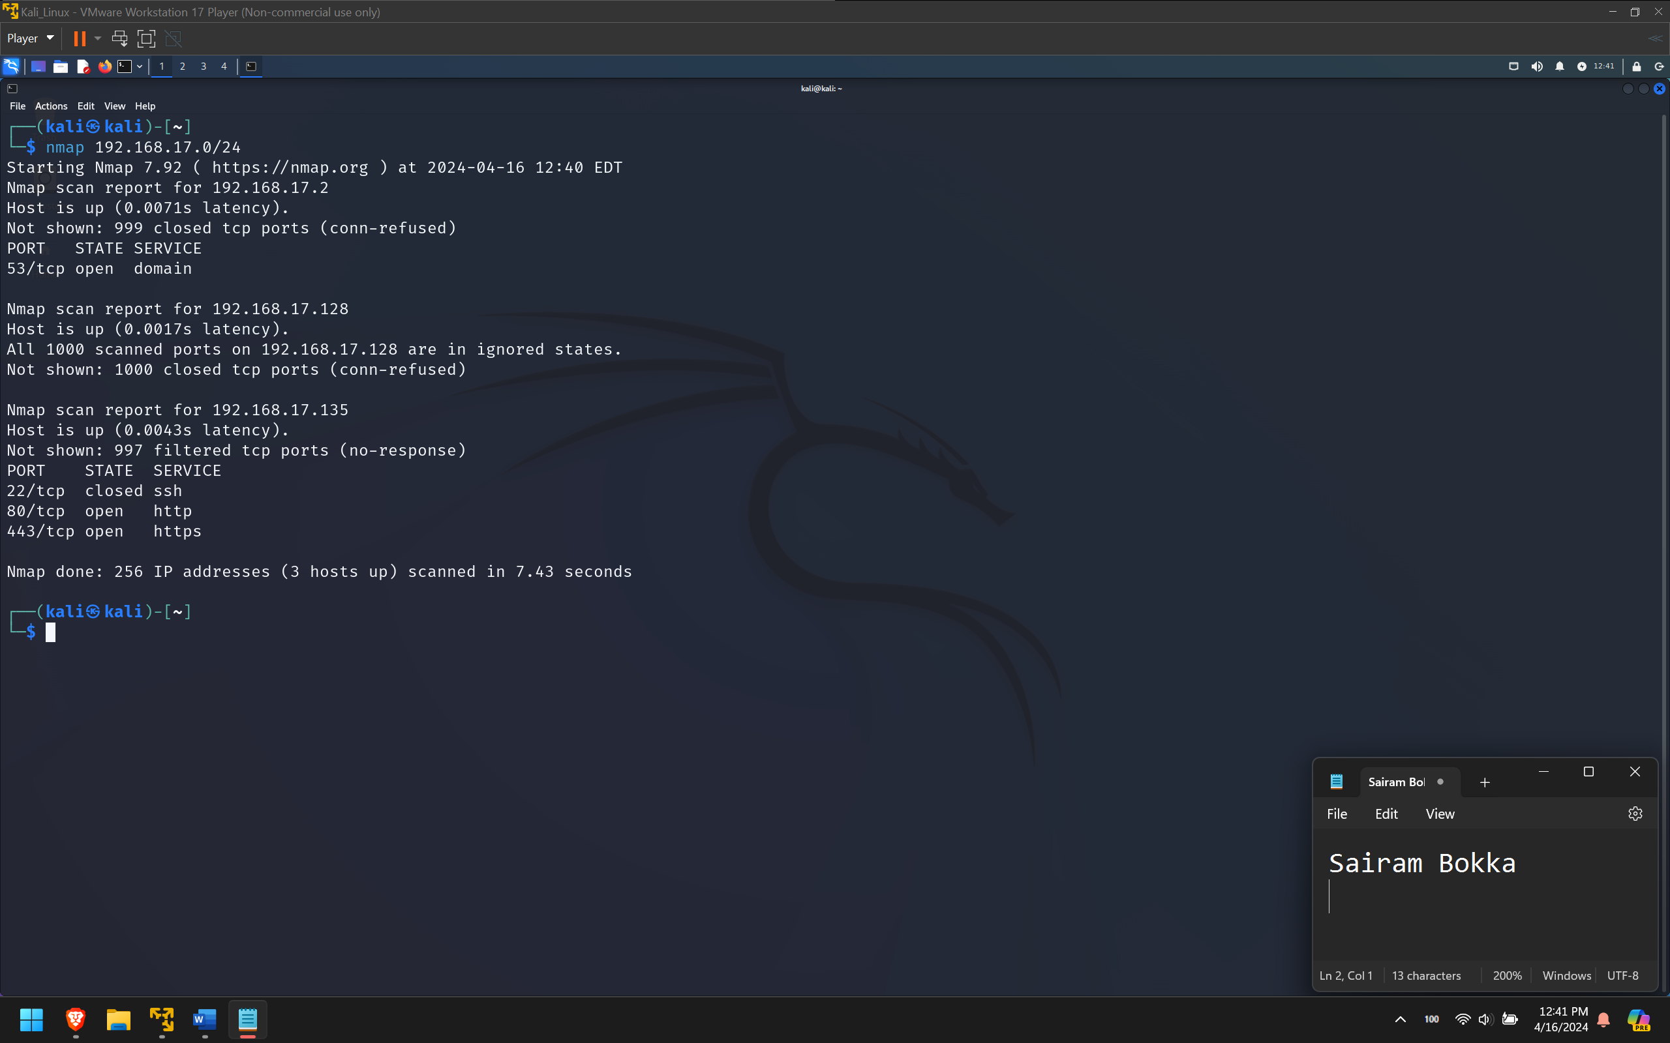
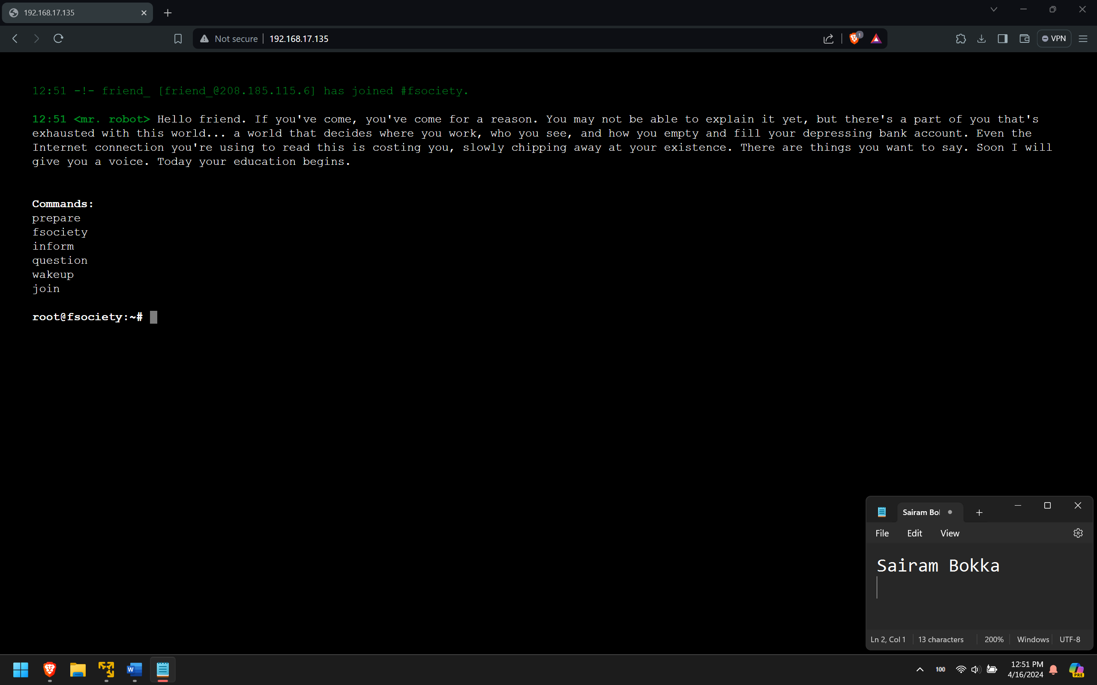
Information gathering
We gather more information about the machine using a detailed nmap scan over all the ports with version detection enabled.
Nmap –sV –p 1-65535 192.168.17.135
We don’t see a lot of open ports but we can see a web application running on port 80. The website seems to be hosting an interactive shell on a web browser. If we type one of the commands as shown on the screen, it gets appended to the IP address

Slide 23
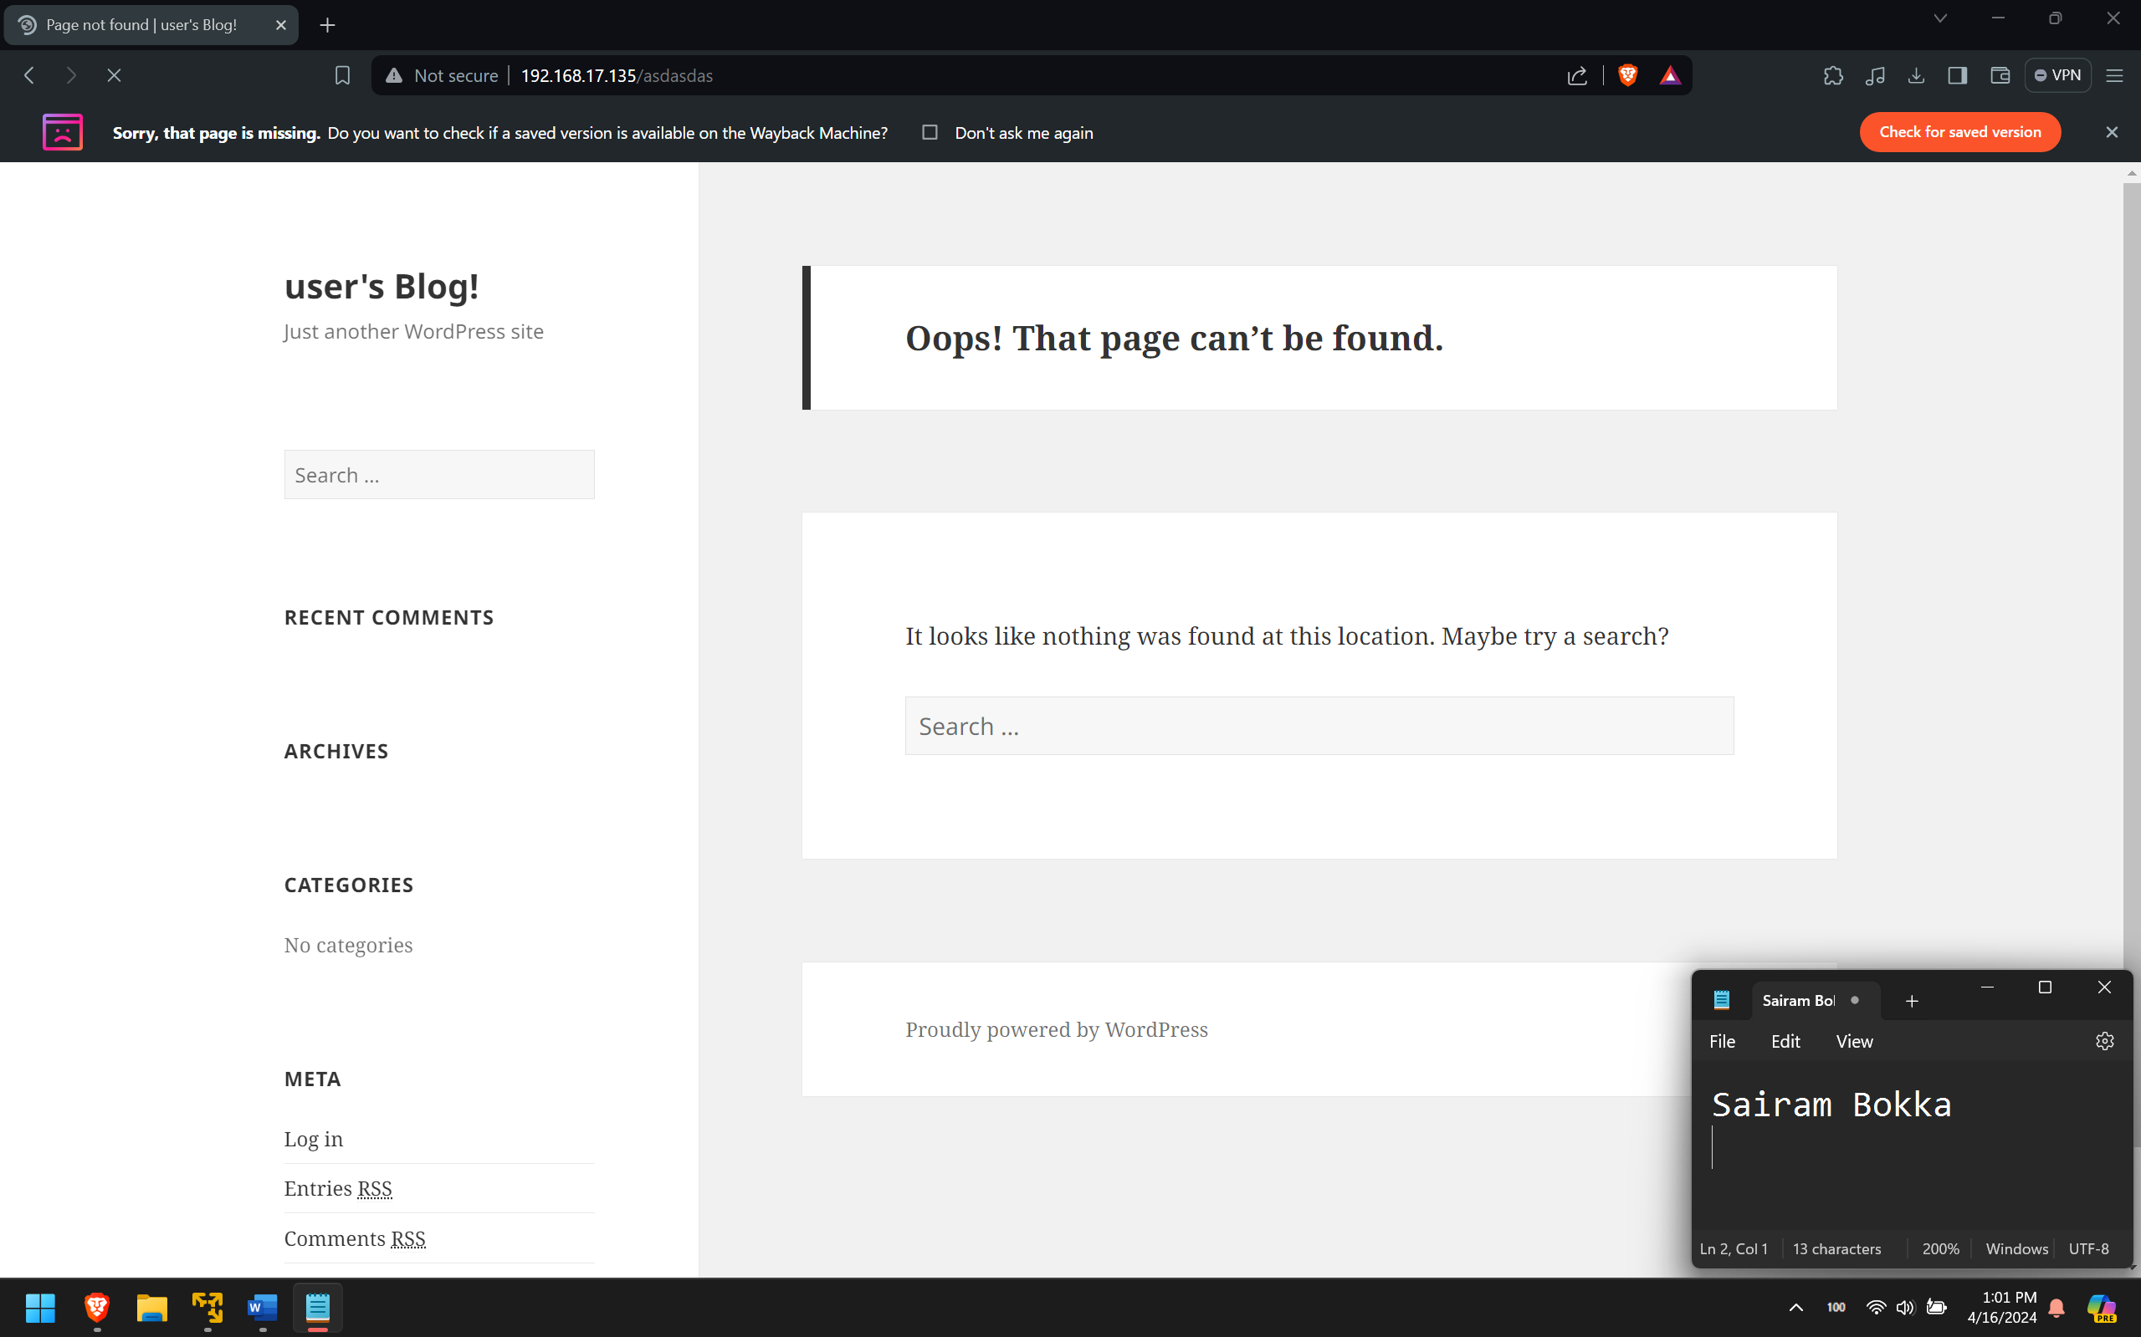
Information gathering
Wordpress Site
Admin Login page

Slide 24
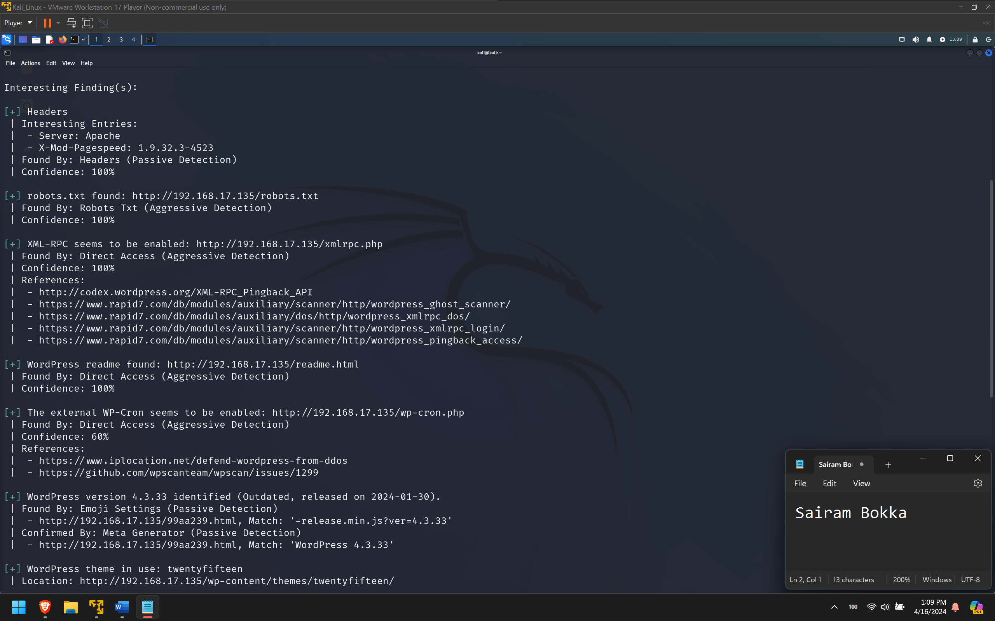
Information gathering
Scan using wpscan tool
Findings:
There is a robots.txt file.
The wordpress version is outdated.
XML-RPC is enabled.

Slide 25
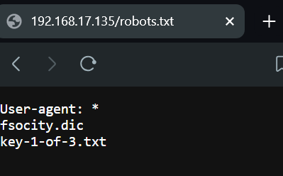
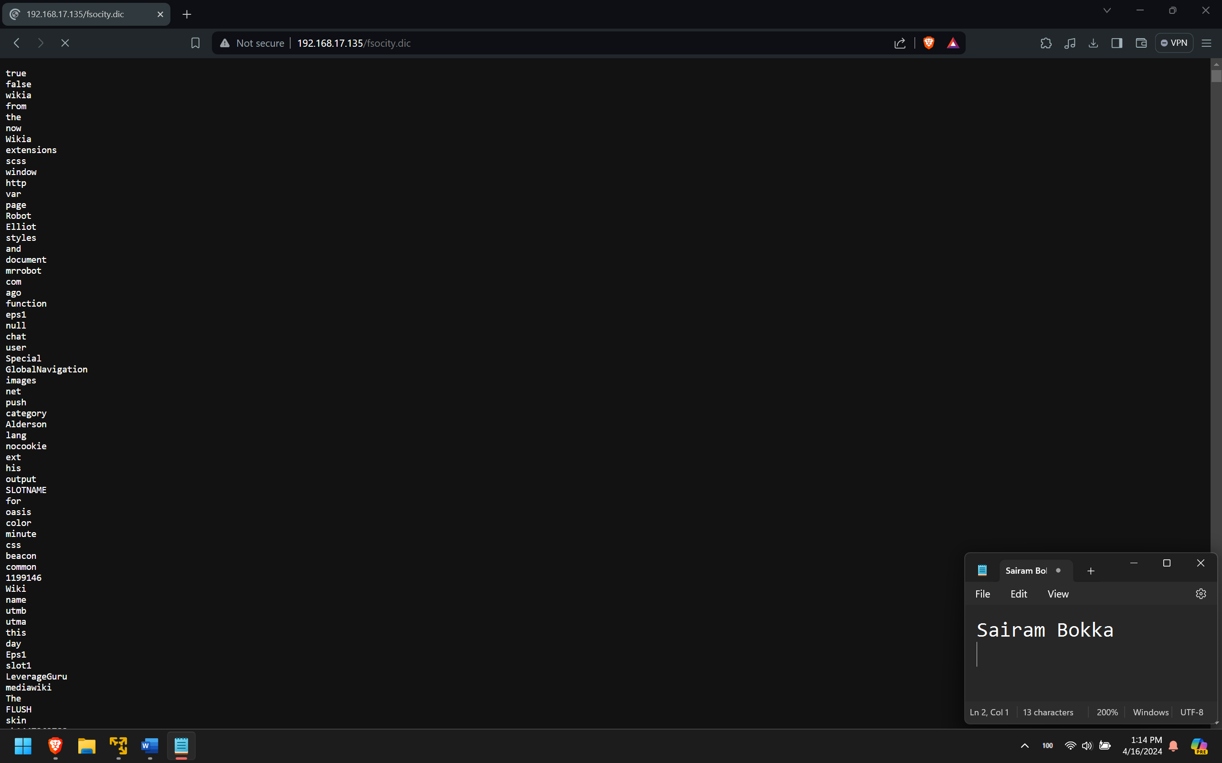
Information gathering
Robots.txt has a dictionary file
Key 1 of 3

Slide 26
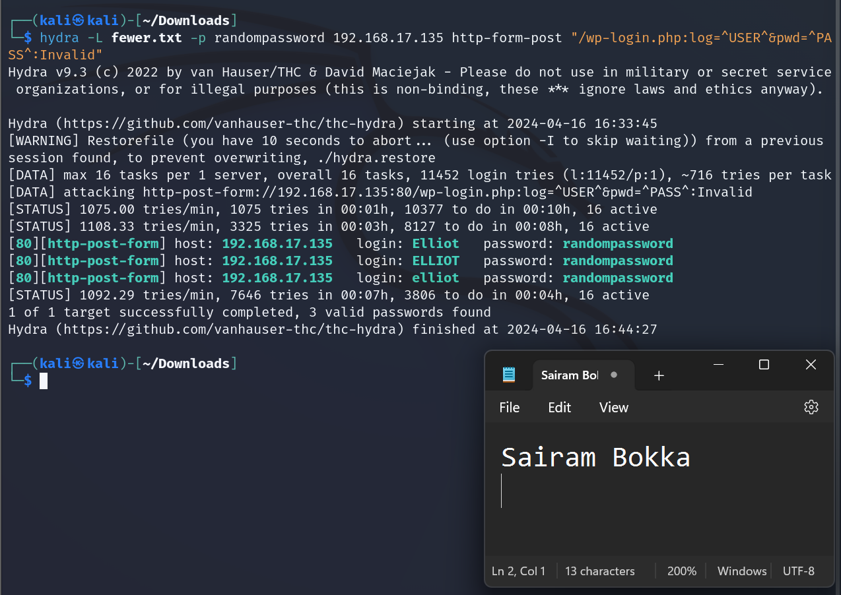
Exploitation
Brute force into login page using hydra and dictionary file we found.
First step would be to find a valid username
Usernames found: Elloit, elloit, ELLIOT

Slide 27
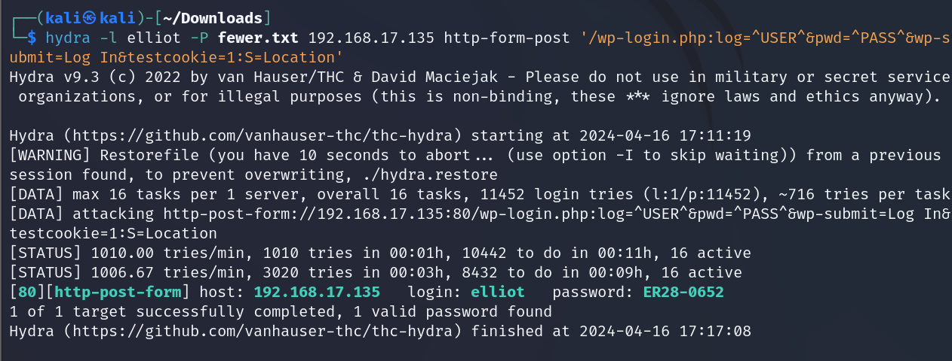
Exploitation
Brute force again to find valid password.
Password found: ER28-0652

Slide 28
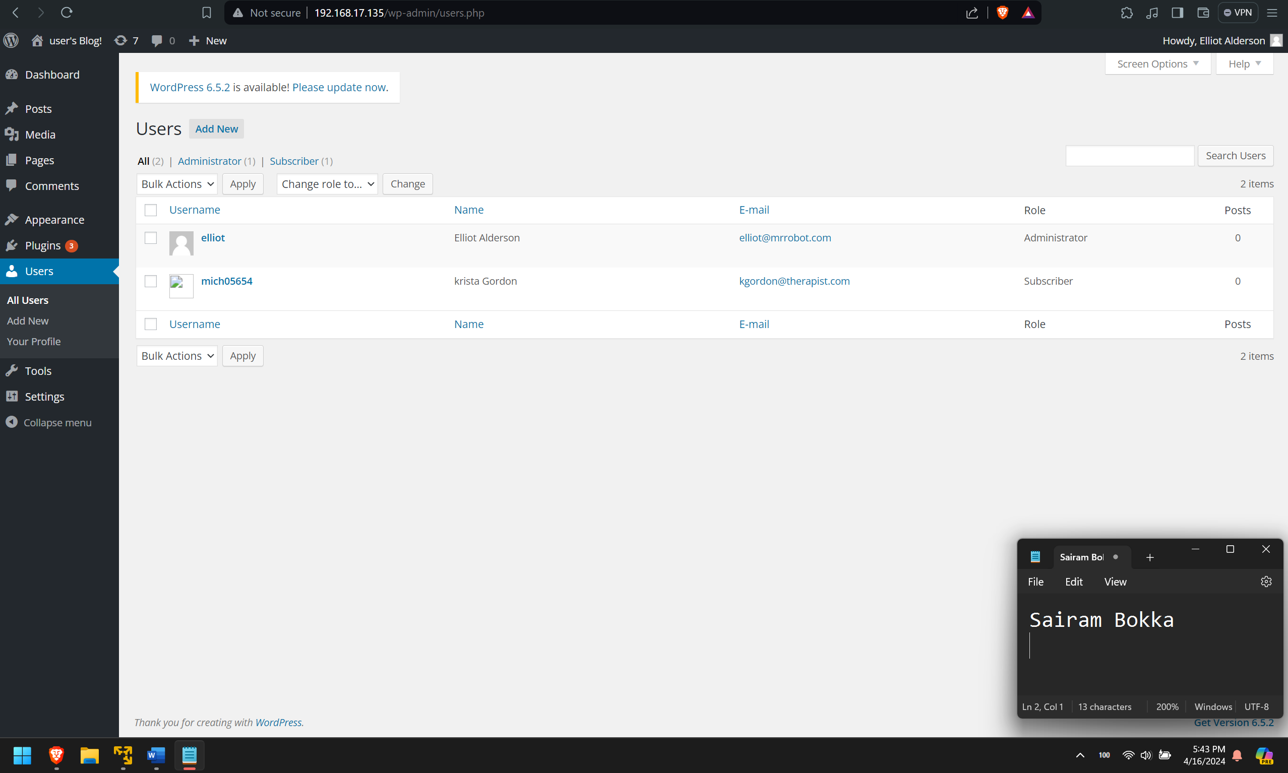
Exploitation
We now have access to wordpress admin site.
We can add or remove users
We can install new plugins or remove existing plugins.

Slide 29
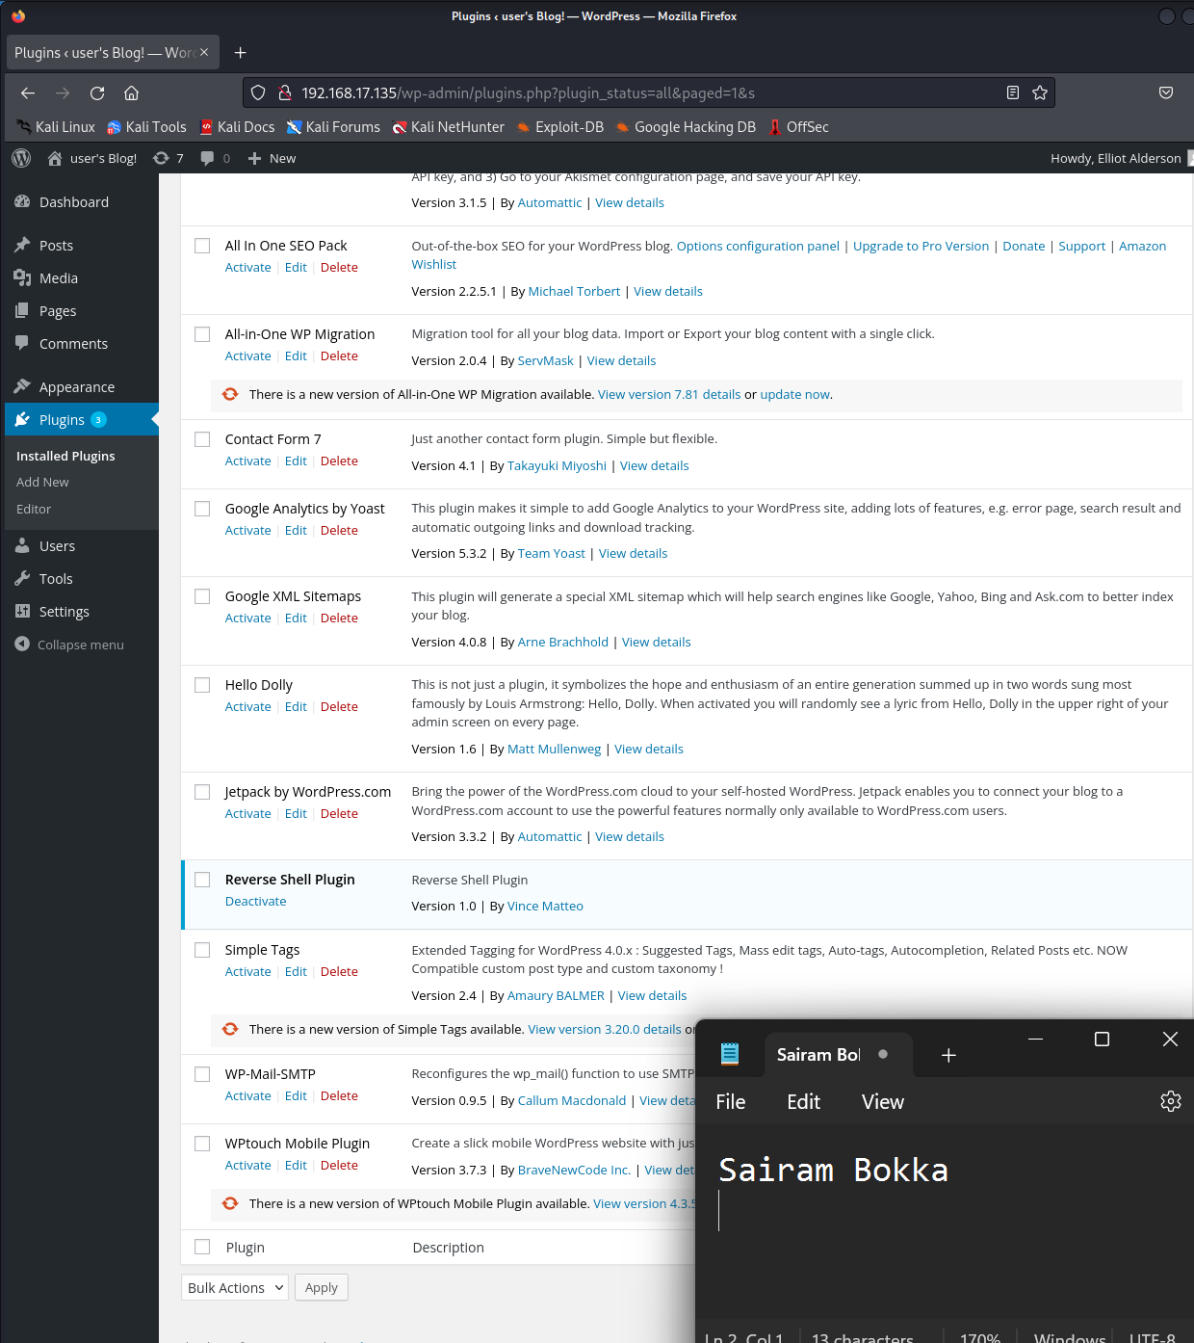
Exploitation
We install a backdoor using a malicious php script and install it as a plugin.
We listen to it using netcat.

Slide 30
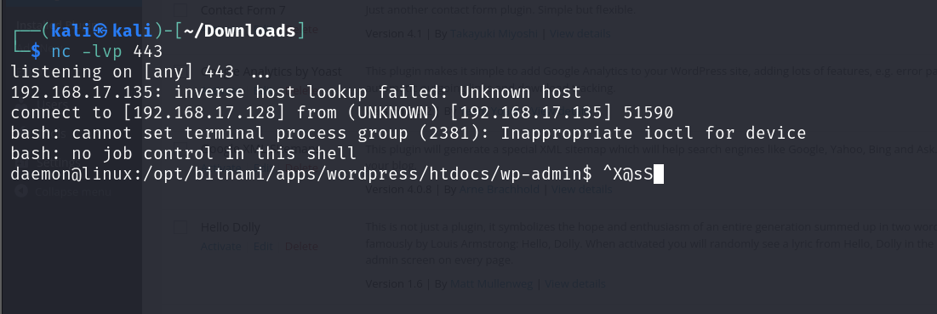
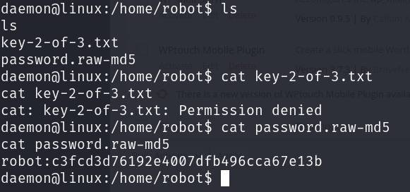
Exploitation
We have remote access to the victim machine
After investigating contents, we find md5 hash and a key called key-2-of-3.txt
We don’t have access to key but we try to decode md5 password.

Slide 31
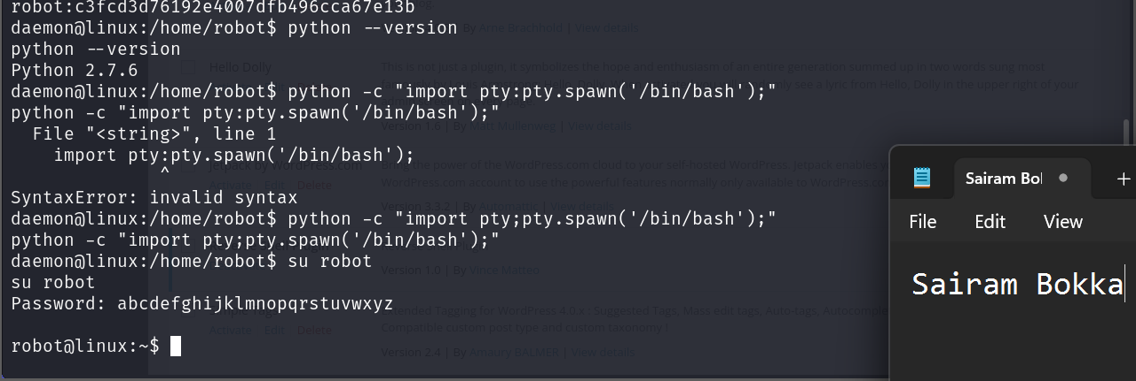
Exploitation
We decode the md5 hash to get the password of user robot.
We login to the machine as robot user and access the key-2-of-3.

Slide 32
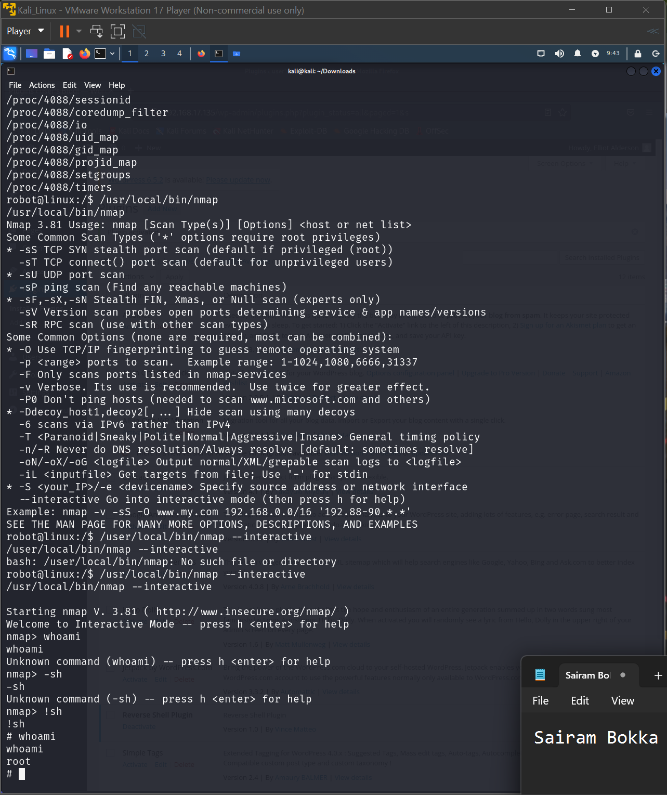
Privilege escalation
We try to find any services running on the machine with root privileges.
We find nmap running with root privileges. We run nmap in interactive mode and spawn a shell using !sh command

Slide 33
Recommendations
Install Wordpress updates
Disabling xmlrpc. php can help protect your WordPress site from DDoS attacks and brute force login attempts
Install a WordPress Firewall Plugin
Disable PHP File Execution in Specific WordPress Folders
Protect WordPress Admin Directory
Add Two-Factor Authentication in WordPress
Disable root access to application that do not need it

Slide 34
THANK YOU
Sairam Bokka​
sbokka1@umbc.edu
VX05251

